Slide 1
Lead Scoring Case Study
Saleha Razvi
Sagar​
Mithun Joseph

Slide 2

Problem statement
X Education is an online education company that receives a large number of leads daily but has a low lead conversion rate of around 30%. They want to identify the most potential leads (known as 'Hot Leads') to improve their lead conversion rate.

Slide 3
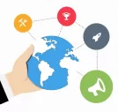
BUSINESS Objective
The Business Objective Is To Build A Logistic Regression Model To Identify The Hot/Potential Leads And Achieve The Lead Conversion Rate To 80%.

Slide 4

Technical approach
Business understanding
Data sourcing
Data cleaning
and
manipulation
eda
1
2
3
4
Data visualisation
Data preparation
Model building
Model evaluation &
conclusions
5
6
7
8

Slide 5
Dataset used : “Leads.csv “ Total number of customers present : 9240 Total number of features : 37 Model used : Logistic Regression The target column in our dataset : “Converted” . We need to reduce the features to maximize the conversion rate. Current Conversion Rate = 38.53%
UNDERSTANDING DATA

Slide 6
Data cleaning
Duplicates
Categorical attribute analysis
Numerical attribute analysis
There are no duplicate values
1.Columns with high data imbalance removed.
2.Columns with missing value percentage more than 45 % removed
Those variables that are connected to lead are removed

Slide 7
Final list of features
Lead Origin
Lead Source
Do Not Email
Total Visits
Total Time Spent on Website
Page Views Per Visit
What is your current occupation
Last Activity

Slide 8
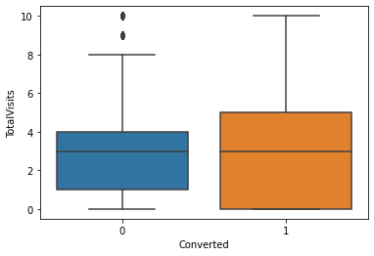
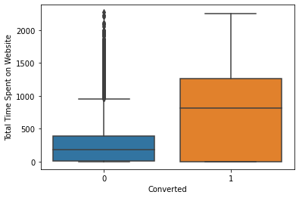
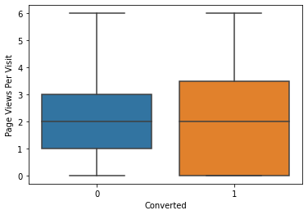
Eda: numerical
Total Visits
The average total visits for both converted and non converted people is found to be the same.
As the median for both converted and non-converted leads are same , nothing conclusive can be said on the basis of variable Total Visits
Total Time Spent On The Website
As can be seen, leads spending more time on website are more likely to convert , thus website should be made more enagaging to increase conversion rate
The mean is found to be higher in case of Converted people rather than non- converted people.
Page Views Per Visit
The average page views for both converted and non converted is found to be the same.Nothing conclusive can be said.

Slide 9
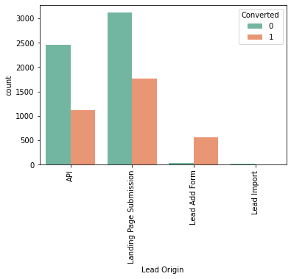
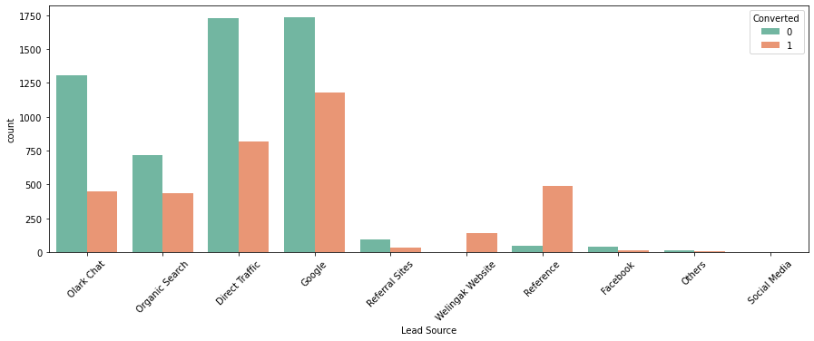
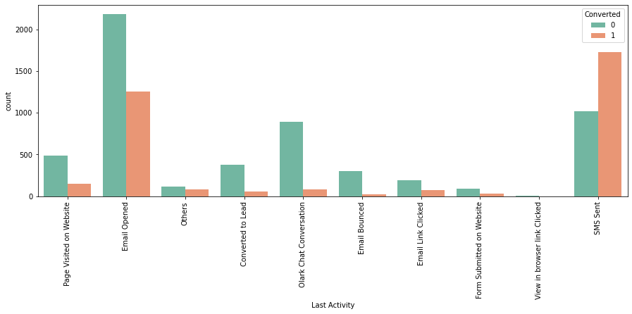



Eda:categorical
Lead Origin
The percentage of Converted people is found to be greater for Landing Page Submission.
Lead Source
Google is found to be the important source for Lead Conversion.
Last Activity
We need to target people via Emails and SMS as it is found that the probability of response in case Converted leads is found to be higher.

Slide 10
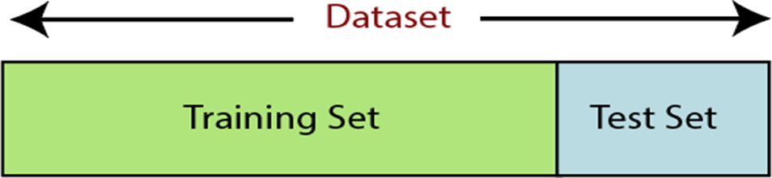
Data Preperation
Binary mapping : Yes/No variables are converted to numerical values to make models.
Dummy variables : For categorial variables as they enable us to run regression equation.
Test Train Split : 70% as train data and 30% as test data with random state =100.
Scaling : To normalize the data within a particular range using standard scaler

Slide 11
Model building
* By checking VIF values in each model and dropping the features with VIF values > 5.
* After making 3 models we get all VIF values < 5. Hence the dependency of variable with another is tolerable.
* The final model has 17 features.

Slide 12
Model evaluation
With the current cut off as 0.5 we have around 79% accuracy, sensitivity of around 63% and specificity of around 89%.

Slide 13
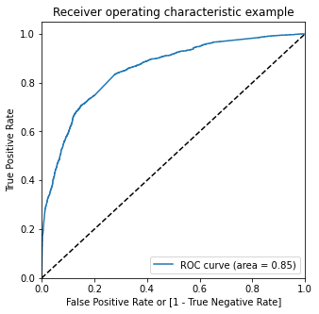
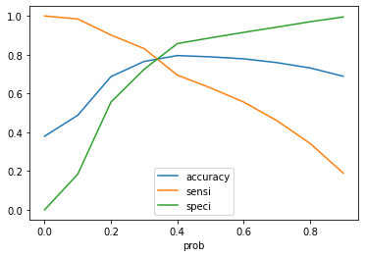
Optimise Cut off (ROC Curve)
1. From the graph it is visible that the optimal cut off is at 0.35
2. On plotting the ROC curve for our data we see that, AUC is around 0.85 which means at around 85% of the times, the model is able to distinguish the 1’s as 1’s and 0’s as 0’s.

Slide 14
Prediction on test set
With the current cut off as 0.35 we have accuracy, sensitivity and specificity of around 84%
Precision and Recall trade off : With the current cut off as 0.35 we have Precision around 78% and Recall around 70%.

Slide 15
conclusion
It was found that the variables that mattered the most in the potential buyers are
1.TotalVisits 2.Total Time Spent on Website 3.Page Views Per Visit
The model evaluation parameters remains to be the same. Hence the model is highly stable.
Before model building the Conversion Rate was found to be 38.53%. After model building, the conversion rate is increased .

Slide 16
Recommendations
It’s good to collect data often and run the model and get updated with the potential leads.
Along with phone calls, it’s good to mail the leads also to keep them reminding
Focusing on Hot Leads will increase the chances of obtaining more value to the business as the number of people we contact are less but the conversion rate is high.
The customer/leads who fills the form are the potential leads.
It’s better to focus on working professionals.
We must majorly focus on leads whose last activity is SMS sent or Email opened.

Slide 17
THANK YOU

